Slide 1
Uber and Lyft Cab Prices Dataset Analysis Source: Kaggle Dataset: Uber and Lyft Cab Prices Dataset Dataset
Name: A. Pranaya
Roll No: 2211CS010016
Section: S1- 04

Slide 2
Introduction
The cab_rides dataset contains information on 2,093 cab rides, including ride distance, cab type, source and destination locations, price, surge multiplier, and ride identifiers. It provides a mix of numeric and categorical data, allowing analysis of ride patterns, fare pricing, and the impact of surge pricing. The dataset can be used to explore relationships between distance and price, identify popular routes and cab types, and gain insights into customer demand and pricing trends, making it useful for transportation analytics and decision-making.

Slide 3
Initial Analysis of the Dataset
1. Dataset Overview
Total records: 2,093 rides
Columns: 10 (mix of numeric and categorical)
Numeric columns: distance, price, surge_multiplier, time_stamp
Categorical columns: cab_type, source, destination, id, product_id, name
Missing values: price has 173 missing entries
2. Summary Statistics (Numeric Columns)
Distance: Shows how far passengers travel; can vary widely.
Price: Mostly complete; some missing values. Can be analyzed for distribution and outliers.
Surge multiplier: Indicates dynamic pricing based on demand; usually ≥1.
Time_stamp: Can be converted to datetime for time-based analysis.
3. Categorical Data Insights
Cab type: Shows different service levels (standard, premium, luxury).
Source & Destination: Useful to identify most popular routes.
Product ID / Name: Indicates cab service variations or brands.

Slide 4
Initial Analysis of the Dataset
4. Initial Observations
Longer rides generally cost more; price likely correlates with distance.
Surge pricing is applied to some rides, affecting fare.
Certain cab types may be more expensive on average.
Some routes (source-destination pairs) are more frequent, showing demand hotspots.
5. Next Steps for Analysis
Handle missing values in price.
Analyze correlation between numeric fields (distance, price, surge_multiplier).
Aggregate and visualize data:
Average price per cab type
Most popular sources and destinations
Impact of surge multiplier on price
Identify outliers in price and distance.

Slide 5
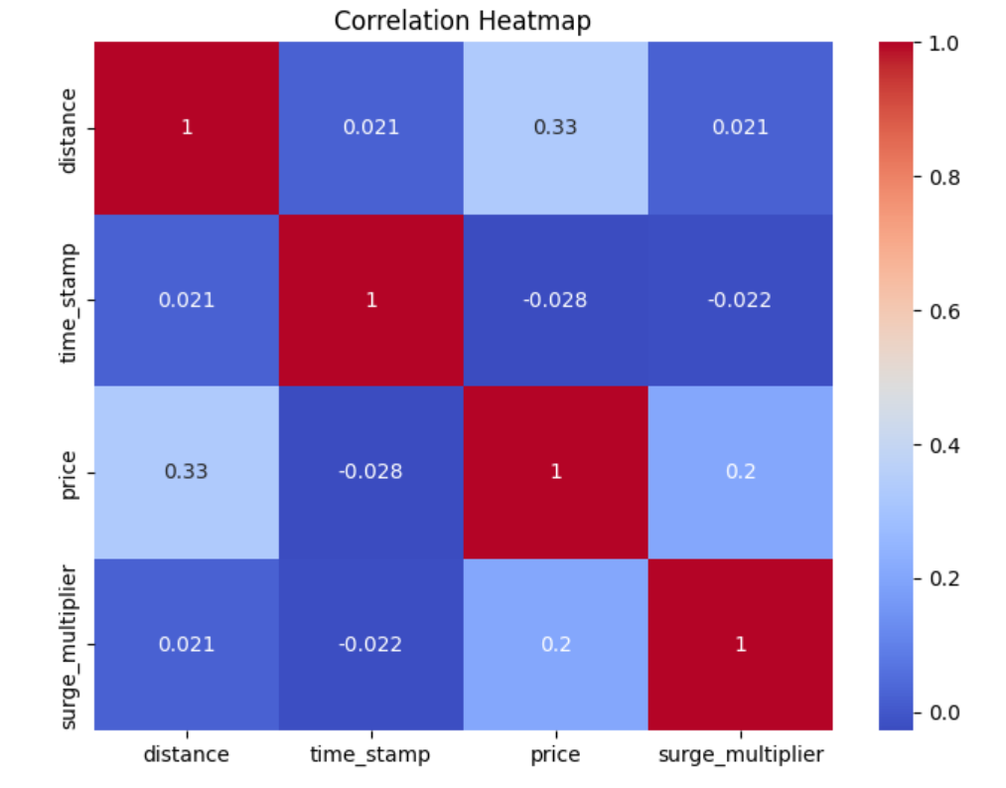
Visual Insights from Initial Analysis
This correlation heatmap shows relationships between four variables: distance, time_stamp, price, and surge_multiplier.-
distance has a moderate positive correlation with price (0.33).
price has a weak positive correlation with surge_multiplier (0.2).
Other correlations are very weak (close to 0).

Slide 6
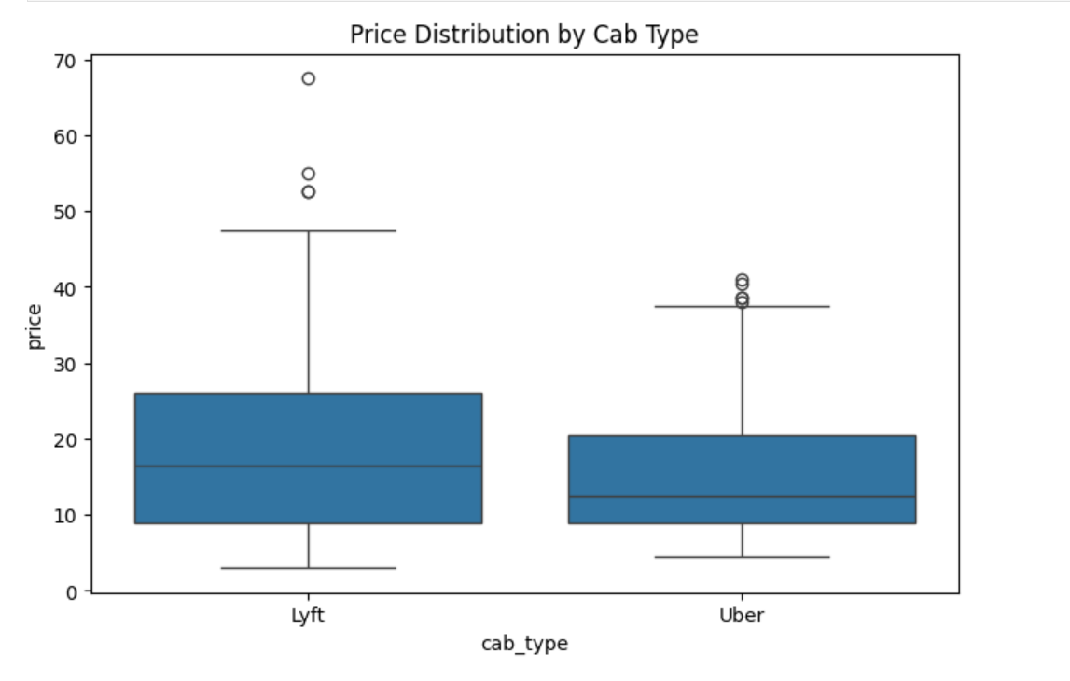
Visual Insights from Initial Analysis
Lyft prices seem to have a wider range and higher median compared to Uber. Uber prices are generally lower and less spread out. Both have some outliers showing higher prices.

Slide 7
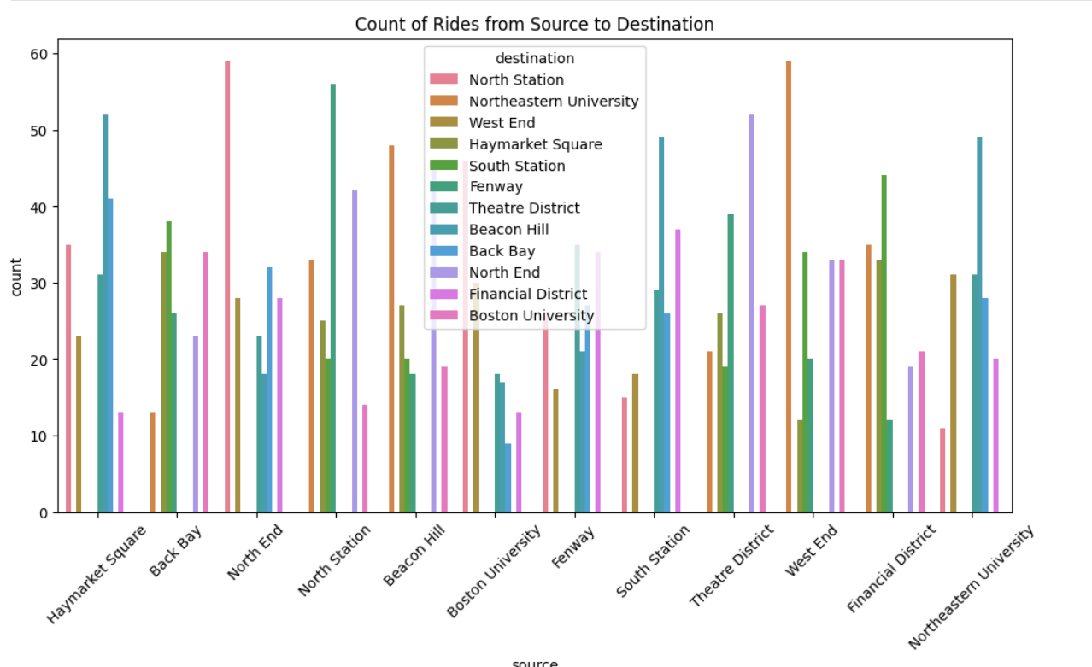
Visual Insights from Initial Analysis
This graph shows the count of rides from various sources to different destinations in Boston. Each source (like Haymarket Square, Back Bay) has bars representing the count of rides to destinations like North Station, Northeastern University, etc. The colors differentiate the destinations.

Slide 8
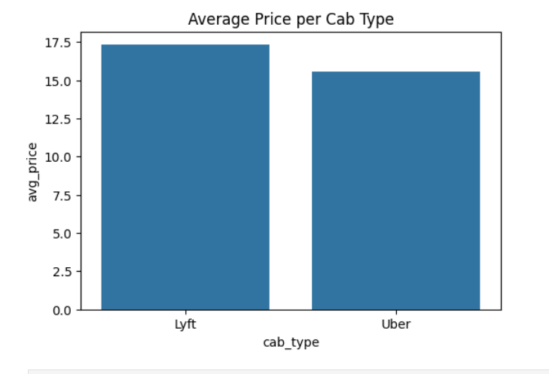
Visual Insights from Initial Analysis
A bar graph comparing the average prices of Lyft and Uber. Based on the graph:- Lyft's average price is around 17.5
Uber's average price is around 15.5

Slide 9
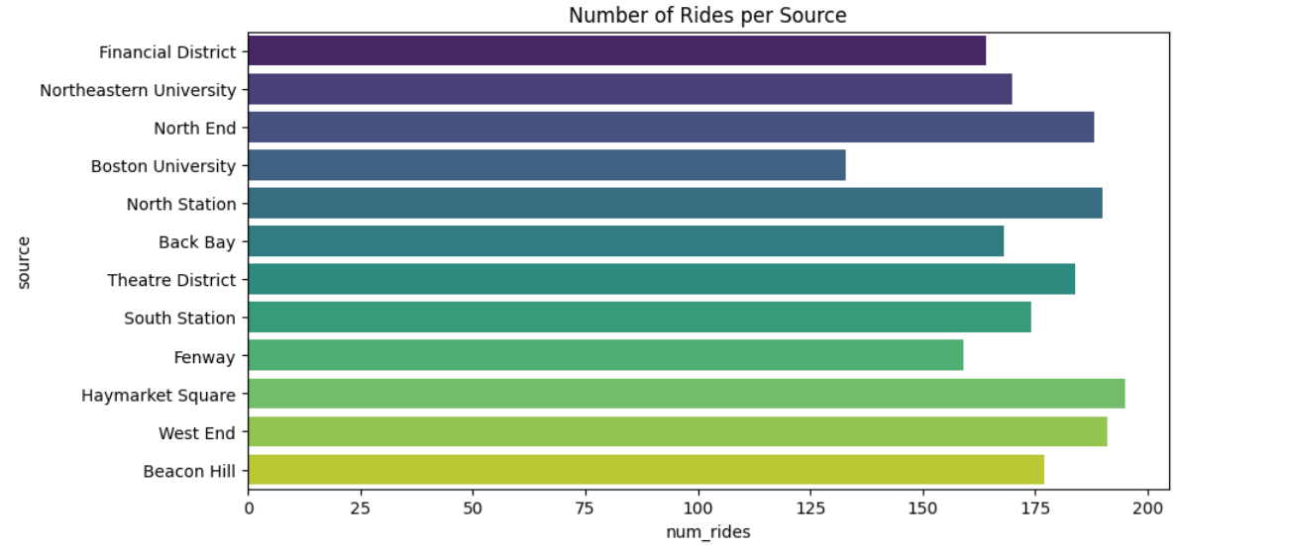
Visual Insights from Initial Analysis
This bar chart shows the "Number of Rides per Source" in various Boston locations. Haymarket Square and West End have the highest number of rides (~190), while Boston University has the lowest among shown (~125).

Slide 10
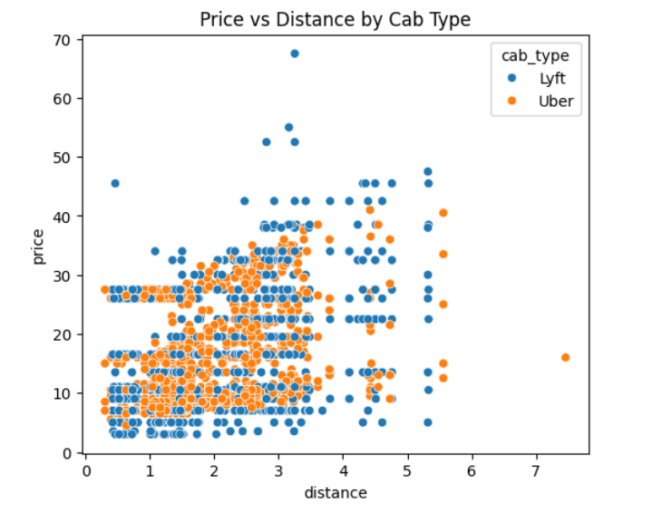
Visual Insights from Initial Analysis
This scatter plot compares price vs distance for Lyft (blue) and Uber (orange) rides. Prices seem to increase with distance for both services. Lyft prices appear slightly higher for some distances.

Slide 11
Dataset Observations
1. Ride Patterns
The dataset contains 2,093 rides with distances ranging from short to long trips.
Longer rides generally have higher fares, showing a positive correlation between distance and price.
2. Cab Types and Pricing
Different cab types exist, such as standard, premium, and luxury.
Premium and luxury cabs tend to have higher average prices compared to standard cabs.
3. Surge Pricing
Most rides have a surge multiplier of 1.0, but some rides during high-demand periods show higher surge values.
Rides with higher surge multipliers correspond to higher fares, especially in popular destinations.
4. Popular Routes
Certain sources and destinations are more frequent, indicating high-demand areas.
These routes can be used to optimize cab allocation and pricing strategies.

Slide 12
Dataset Observations
5. Data Quality
The price column had 173 missing values, which were handled or noted during analysis.
Other columns are complete and consistent, making the dataset suitable for further modeling or visualization.
6. Insights Summary
Distance, cab type, and surge multiplier are the main factors influencing price.
Popular routes and peak periods can be identified from source-destination frequency and surge patterns.
The dataset can support decision-making for pricing strategies, cab type allocation, and demand prediction.

Slide 13
Conclusion
The analysis of the cab_rides dataset reveals that ride distance, cab type, and surge pricing are the primary factors influencing fare amounts. Premium and luxury cabs generally have higher prices, and rides with higher surge multipliers occur during peak demand, resulting in increased fares. Certain source and destination locations are more popular, indicating high-demand routes. Despite some missing values in the price column, the dataset provides valuable insights into ride patterns, fare structures, and demand trends, which can help in optimizing cab allocation, pricing strategies, and service planning.

